Slide 1
Improve In-distribution Generalization Performance
Jintong Gao
2024.10.31

Slide 2
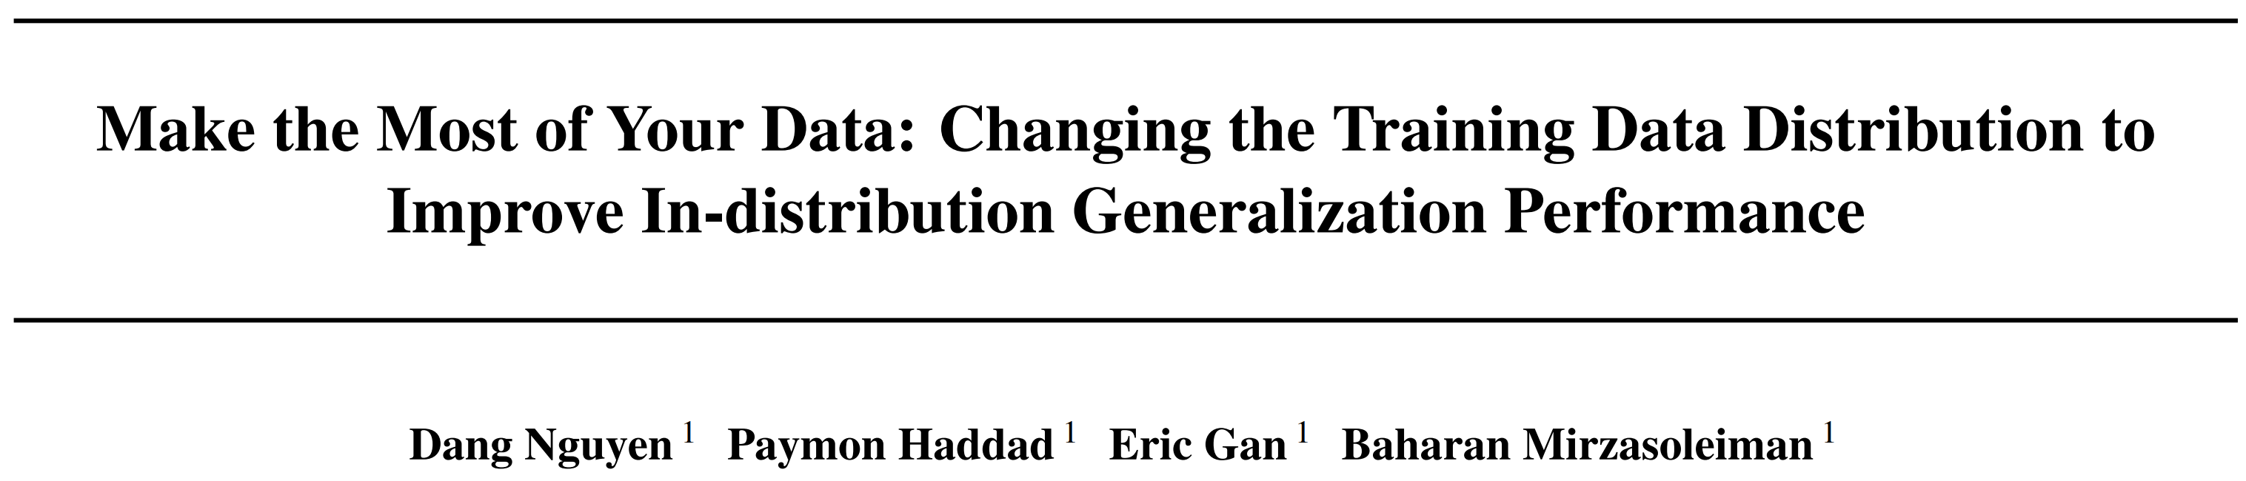
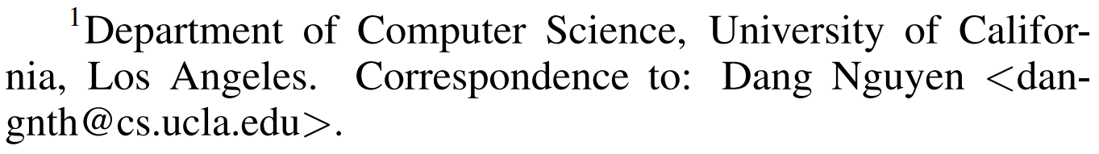
NeurIPS 2024

Slide 3
Motivation:
Can we modify the training data distribution to encourage the underlying optimization method
toward finding solutions with superior generalization performance on in-distribution data?
Finding optimized solutions:
Gradient-based by designing more effective optimization methods (SGD, ADAM, SAM, AdaHessian).
Model-based structures. (SMBO, Neural Architecture Search (NAS), ENAS)
Higher-capacity-based analytics. (Effective model complexity, double-descent)

Slide 4
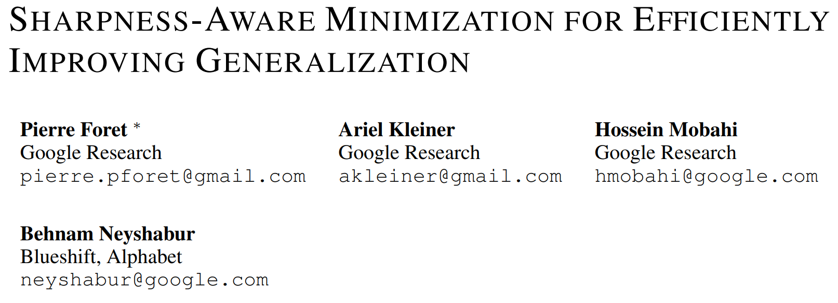
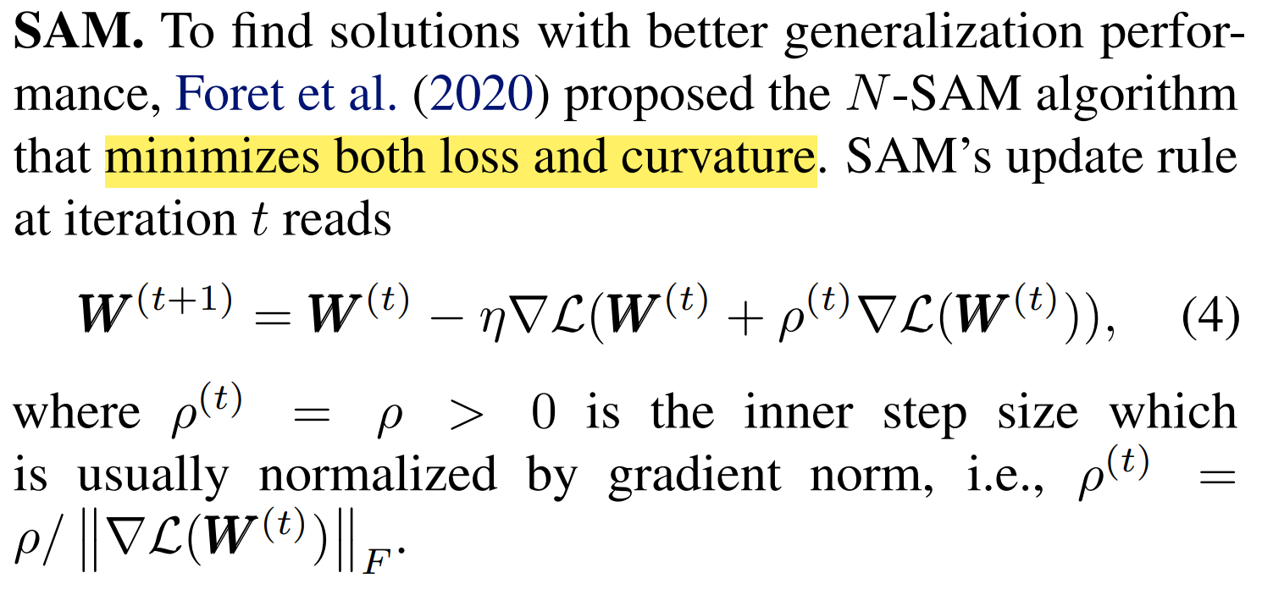
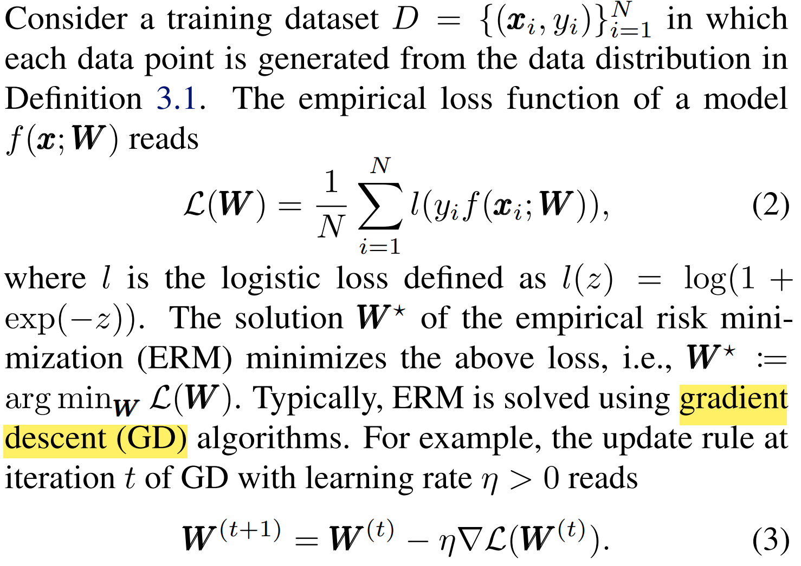
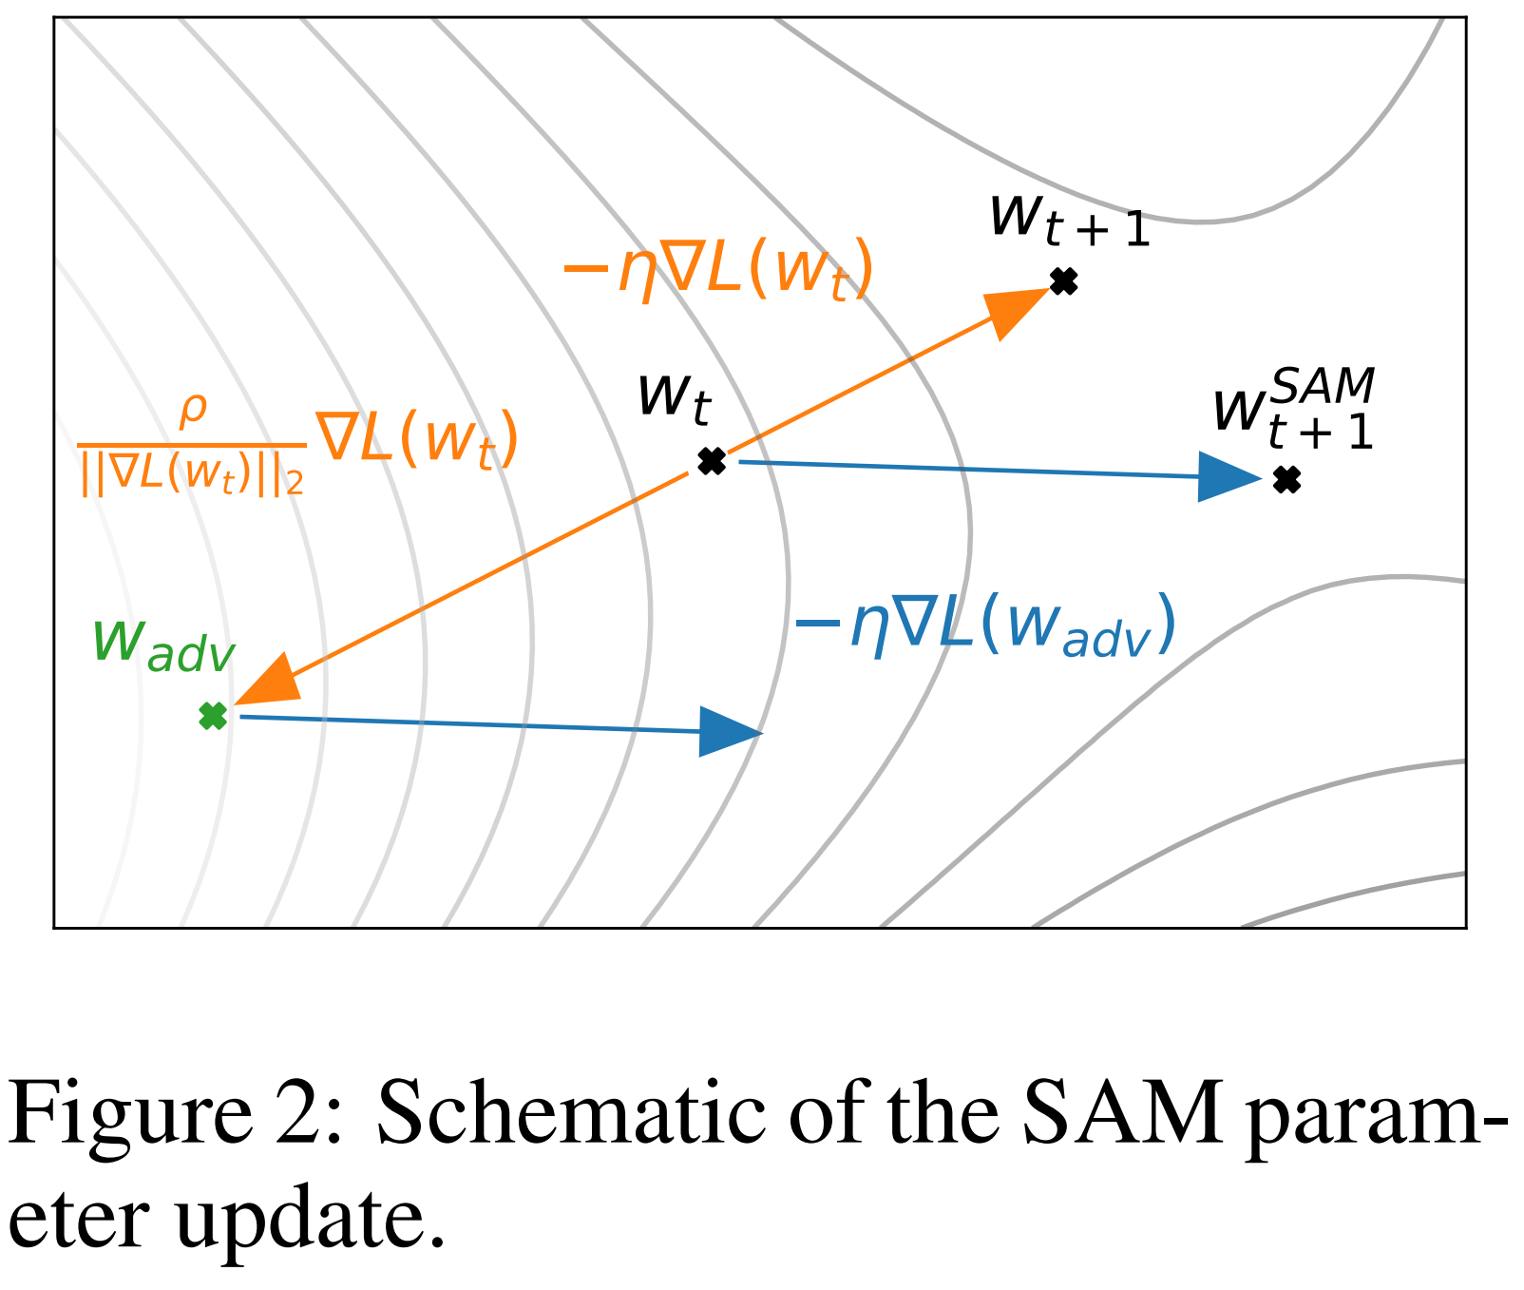
Gradient descent (GD) & Sharpness-aware-minimization (SAM)
ICLR 2021

Slide 5
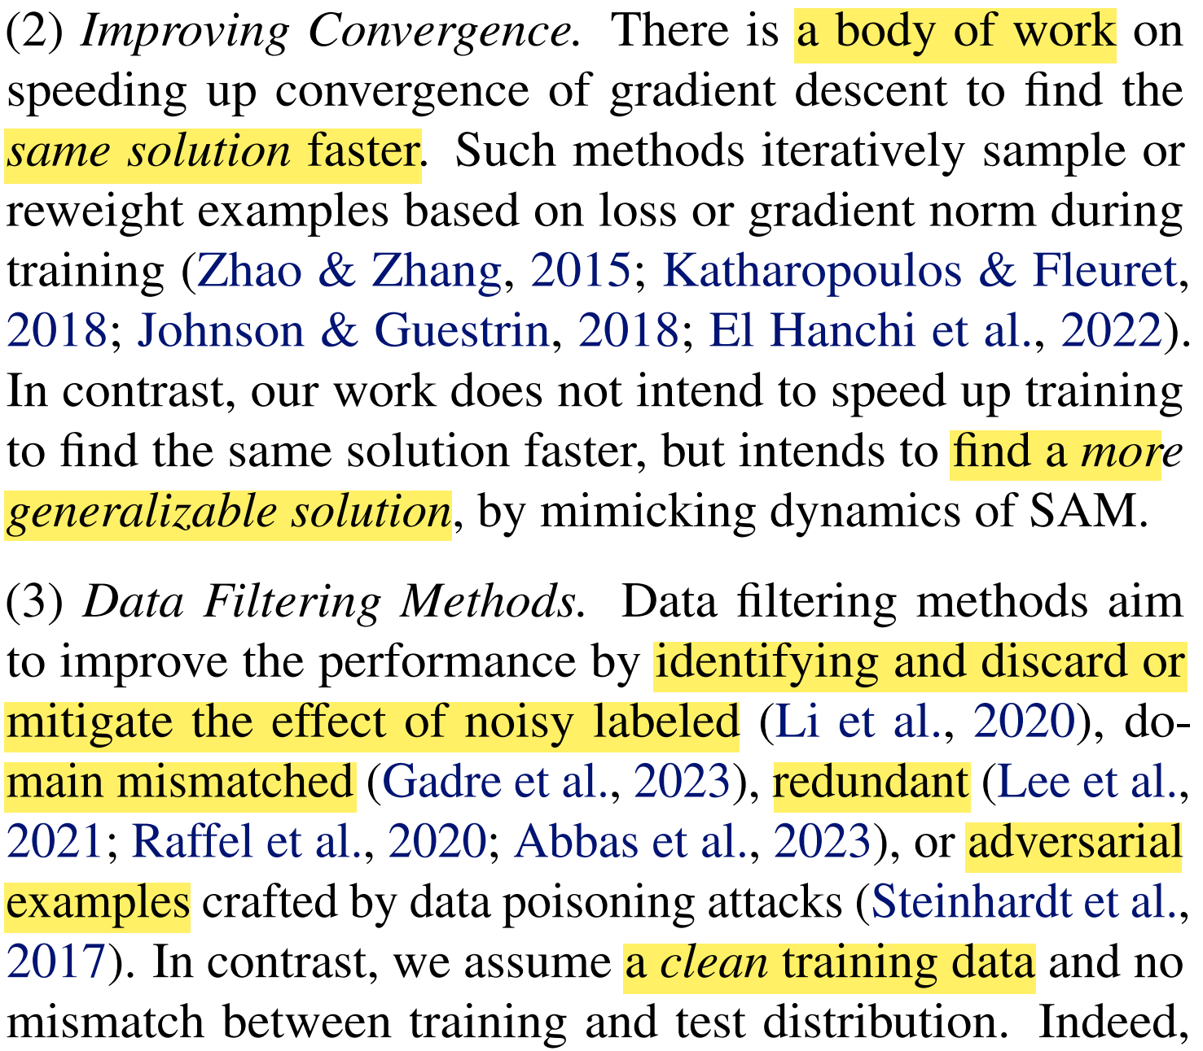
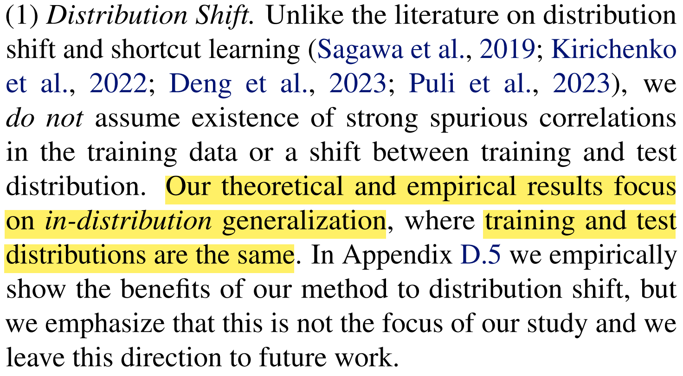
Why gradient descent (GD) < sharpness-aware-minimization (SAM) in-distribution generalization performance?

Slide 6
Why gradient descent (GD) < sharpness-aware-minimization (SAM)?
In early training, both GD and SAM learn easy features faster than difficult features.
SAM learns easy and difficult features more evenly than GD.

Slide 7
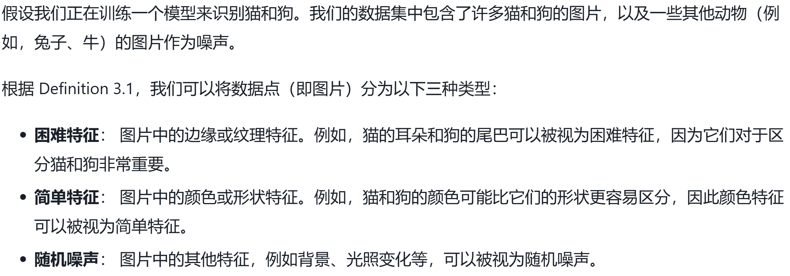
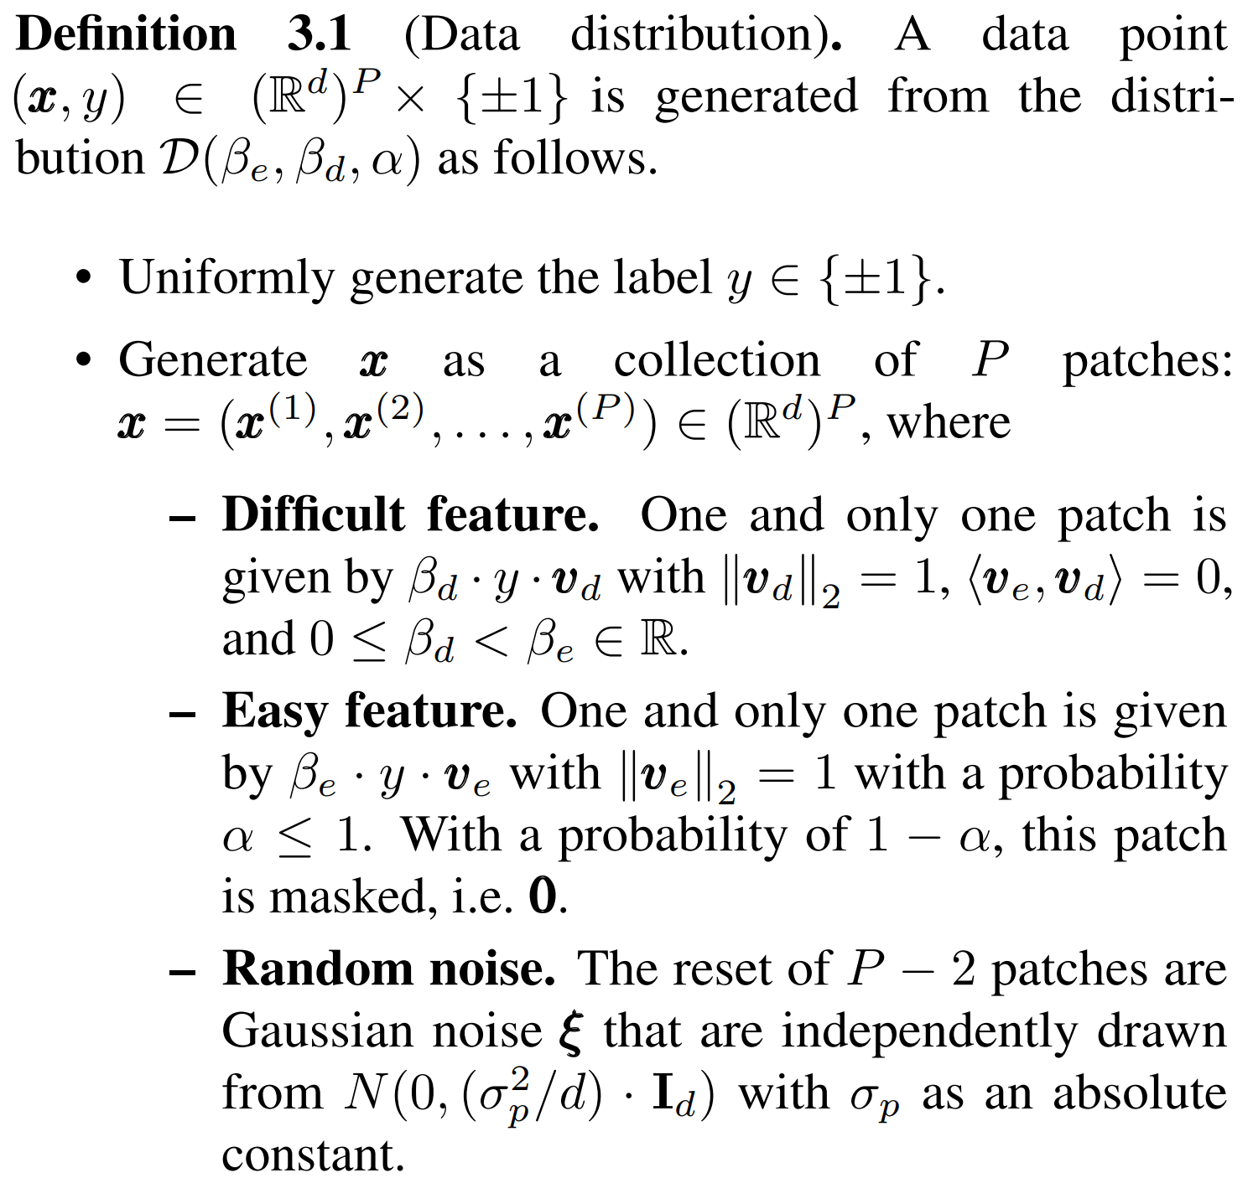
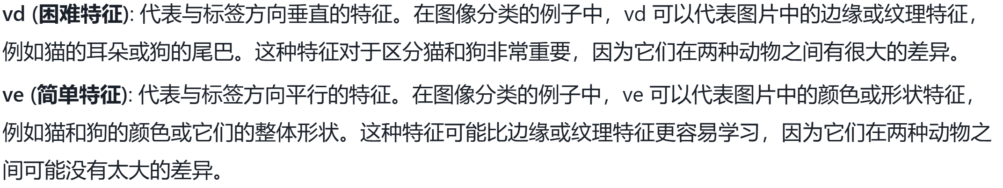
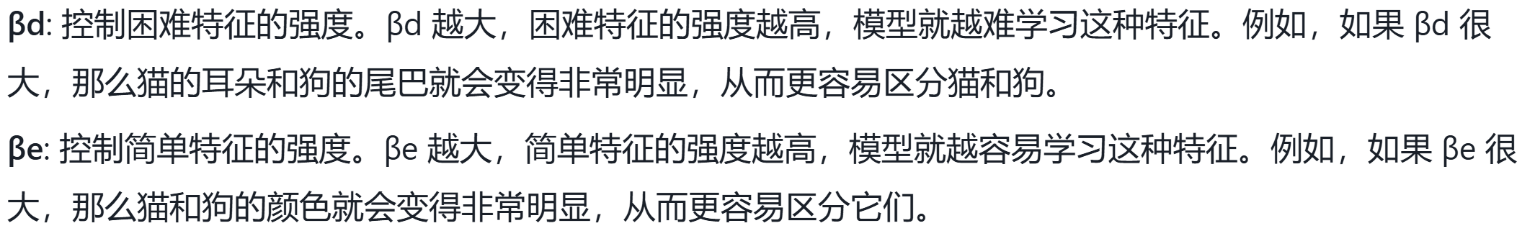
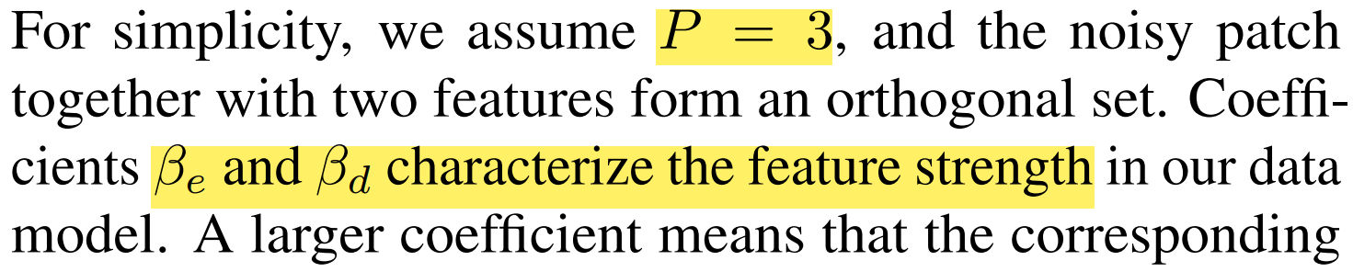
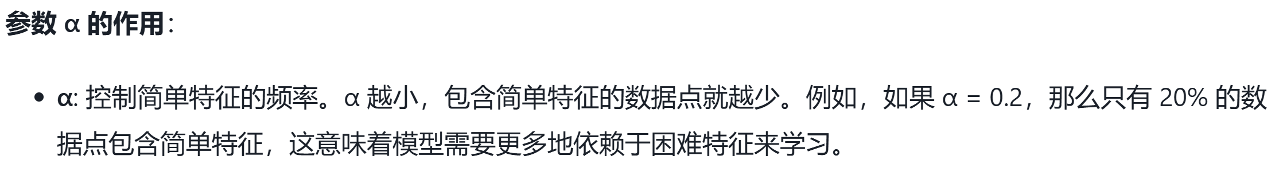

Slide 8
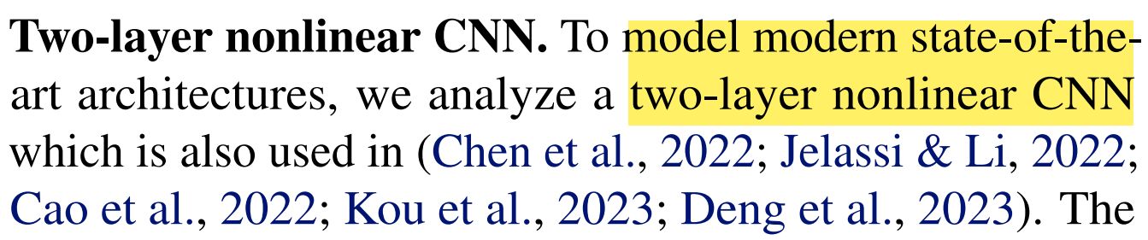
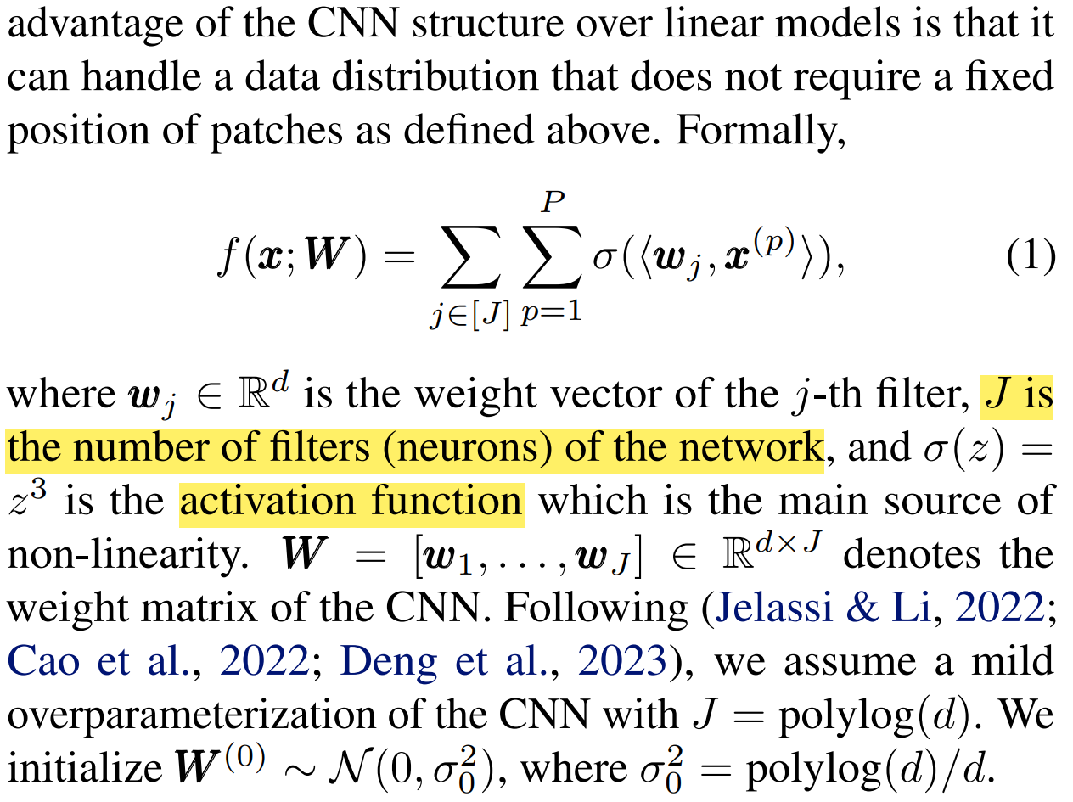

Slide 9
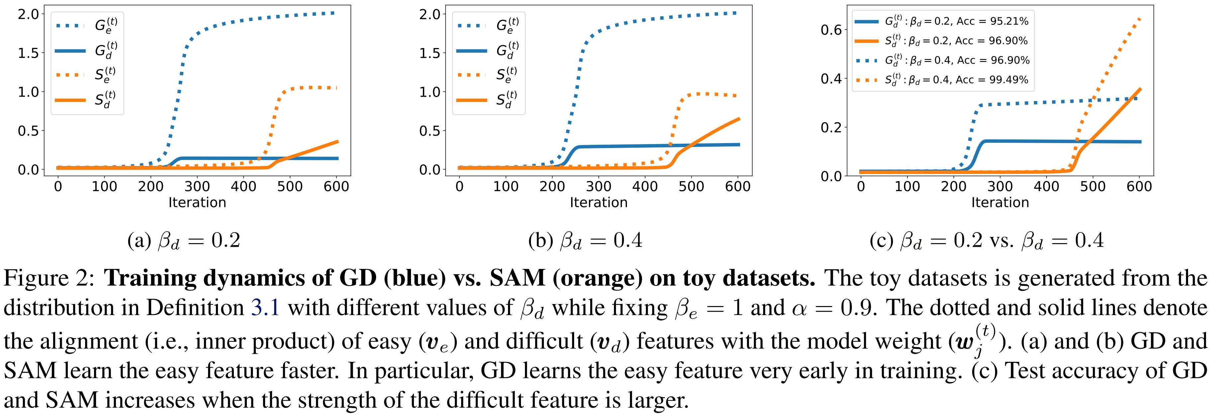
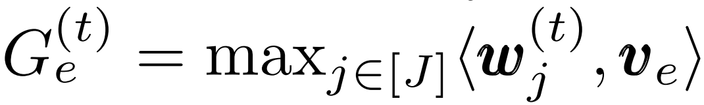
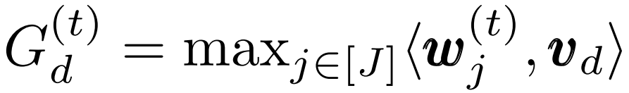
In early training, both GD and SAM learn easy features faster than difficult features.

Slide 10
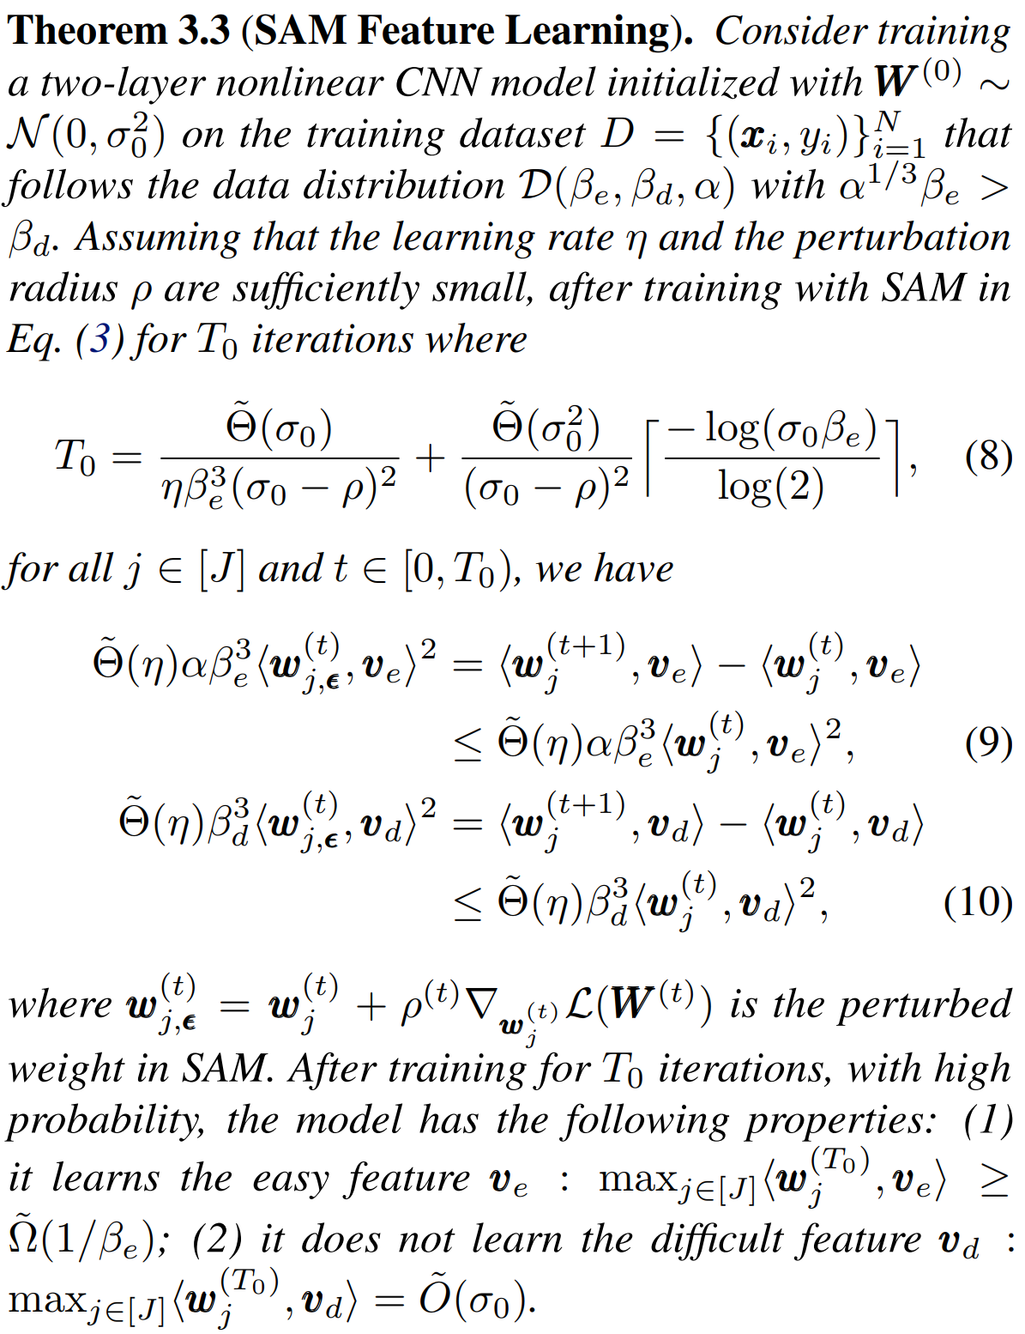
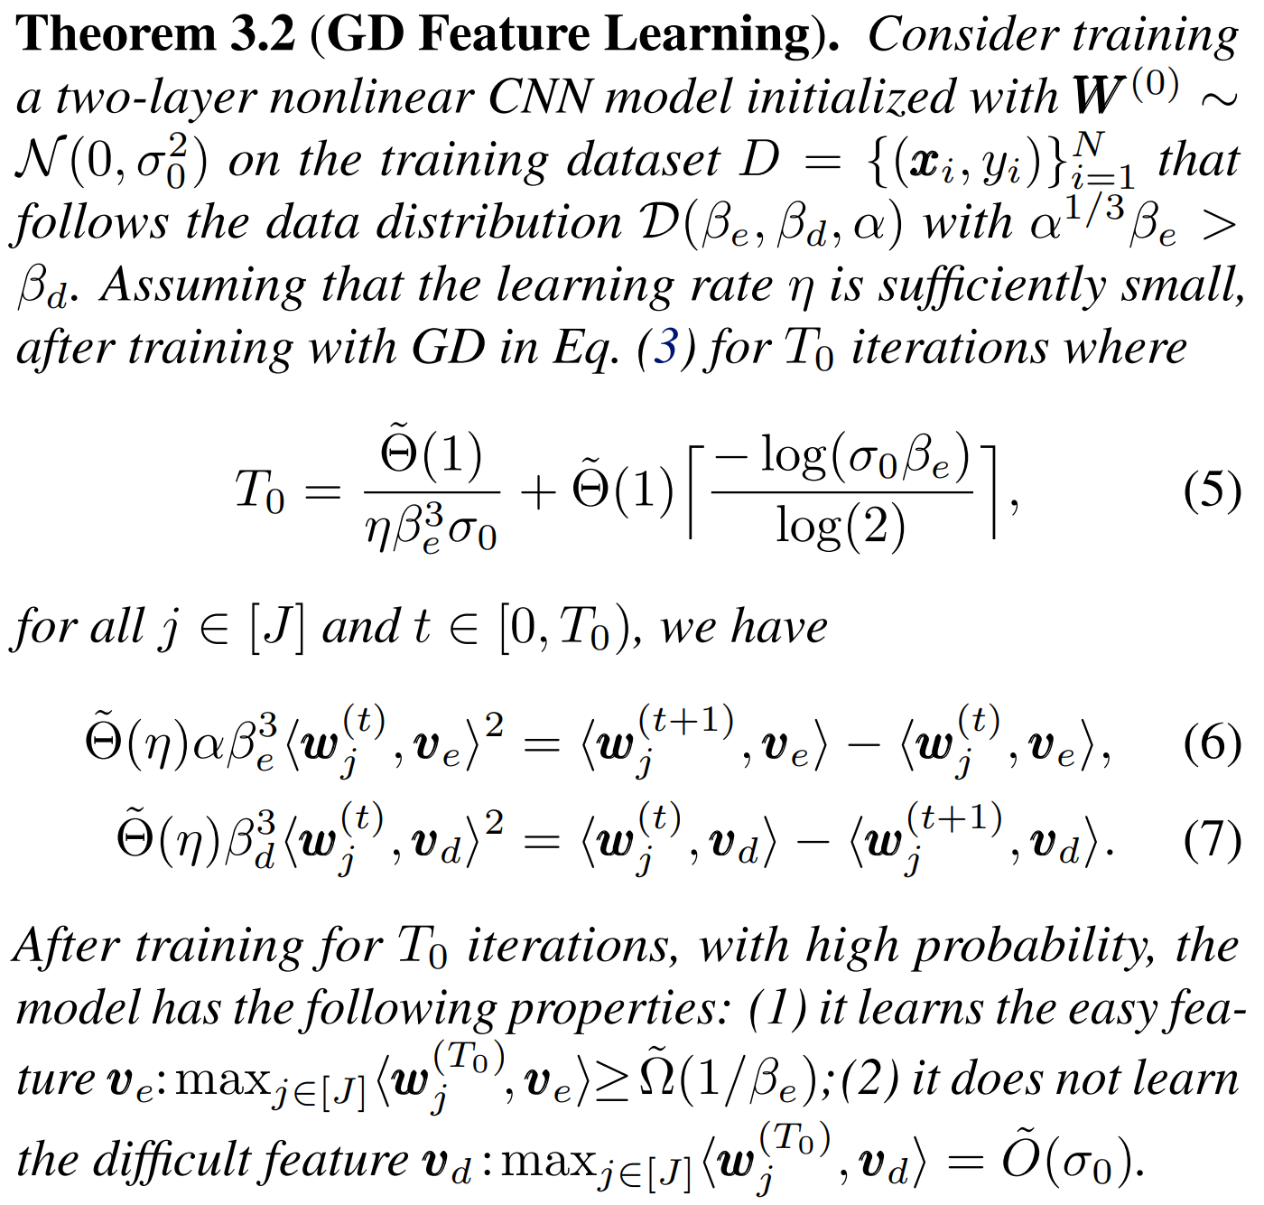

Slide 11
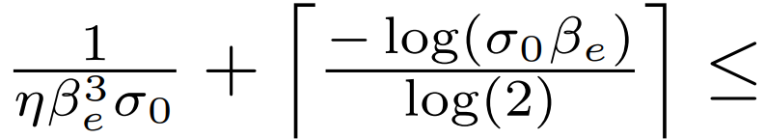
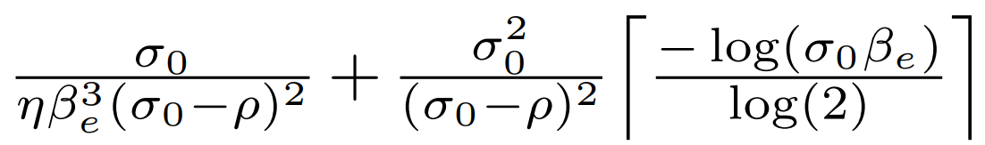
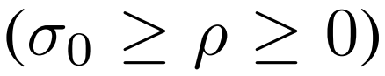

Slide 12
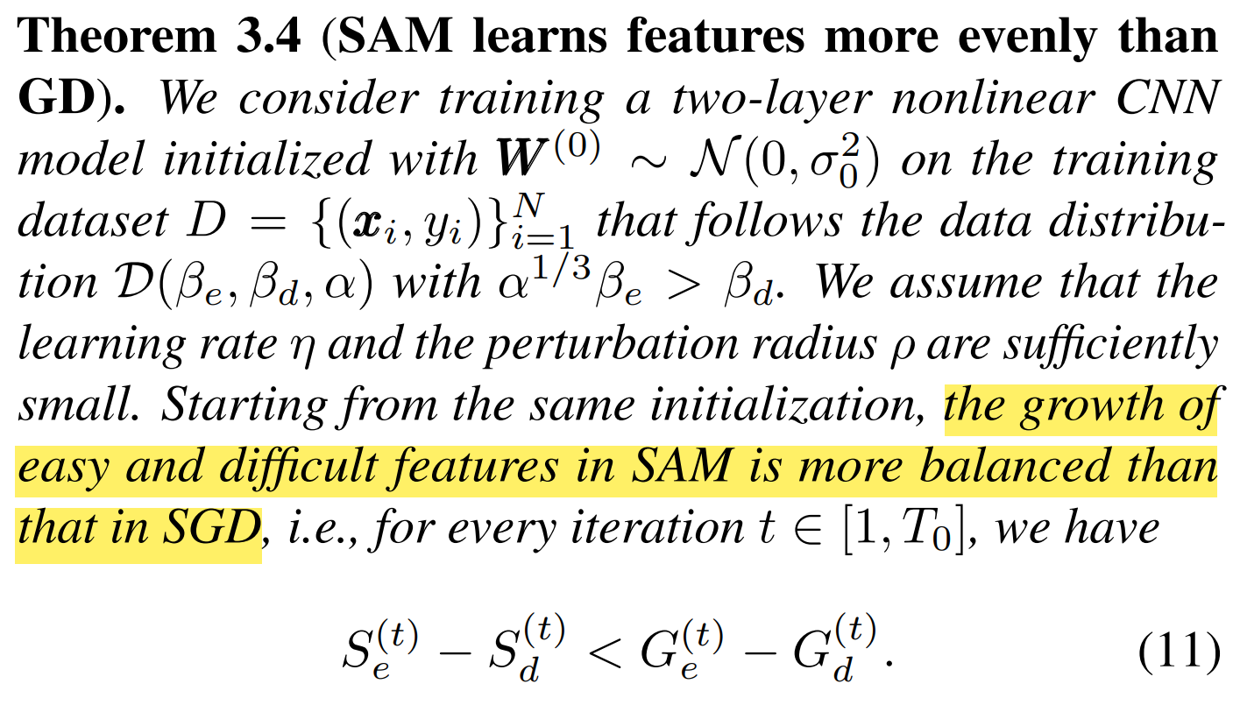
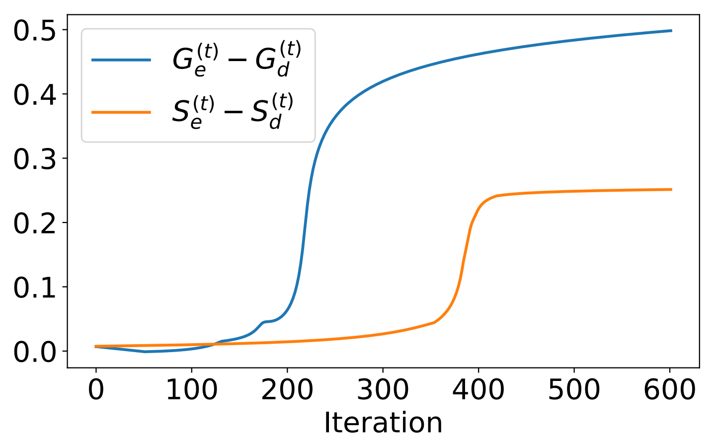
SAM learns easy and difficult features more evenly than GD.

Slide 13
Why gradient descent (GD) < sharpness-aware-minimization (SAM)?
In early training, both GD and SAM learn easy features faster than difficult features.
SAM learns easy and difficult features more evenly than GD.

Slide 14
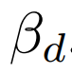
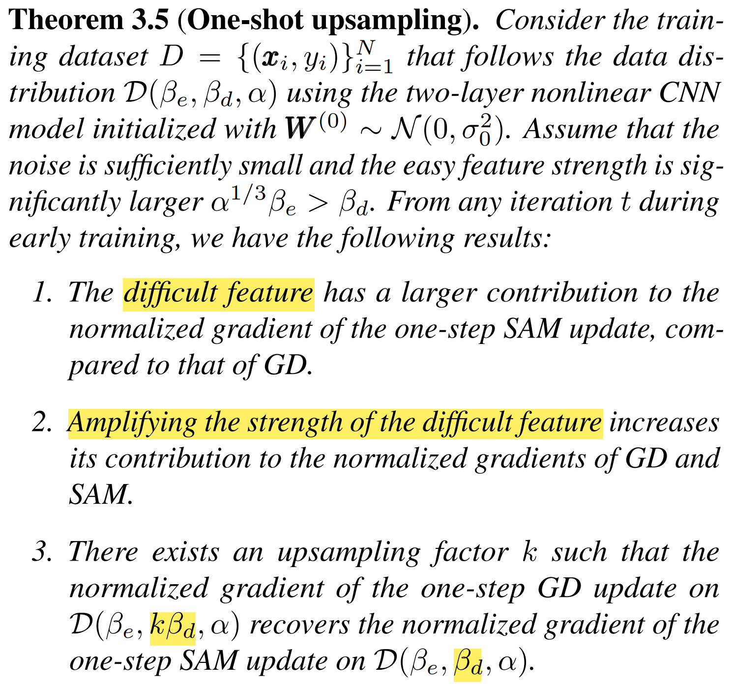
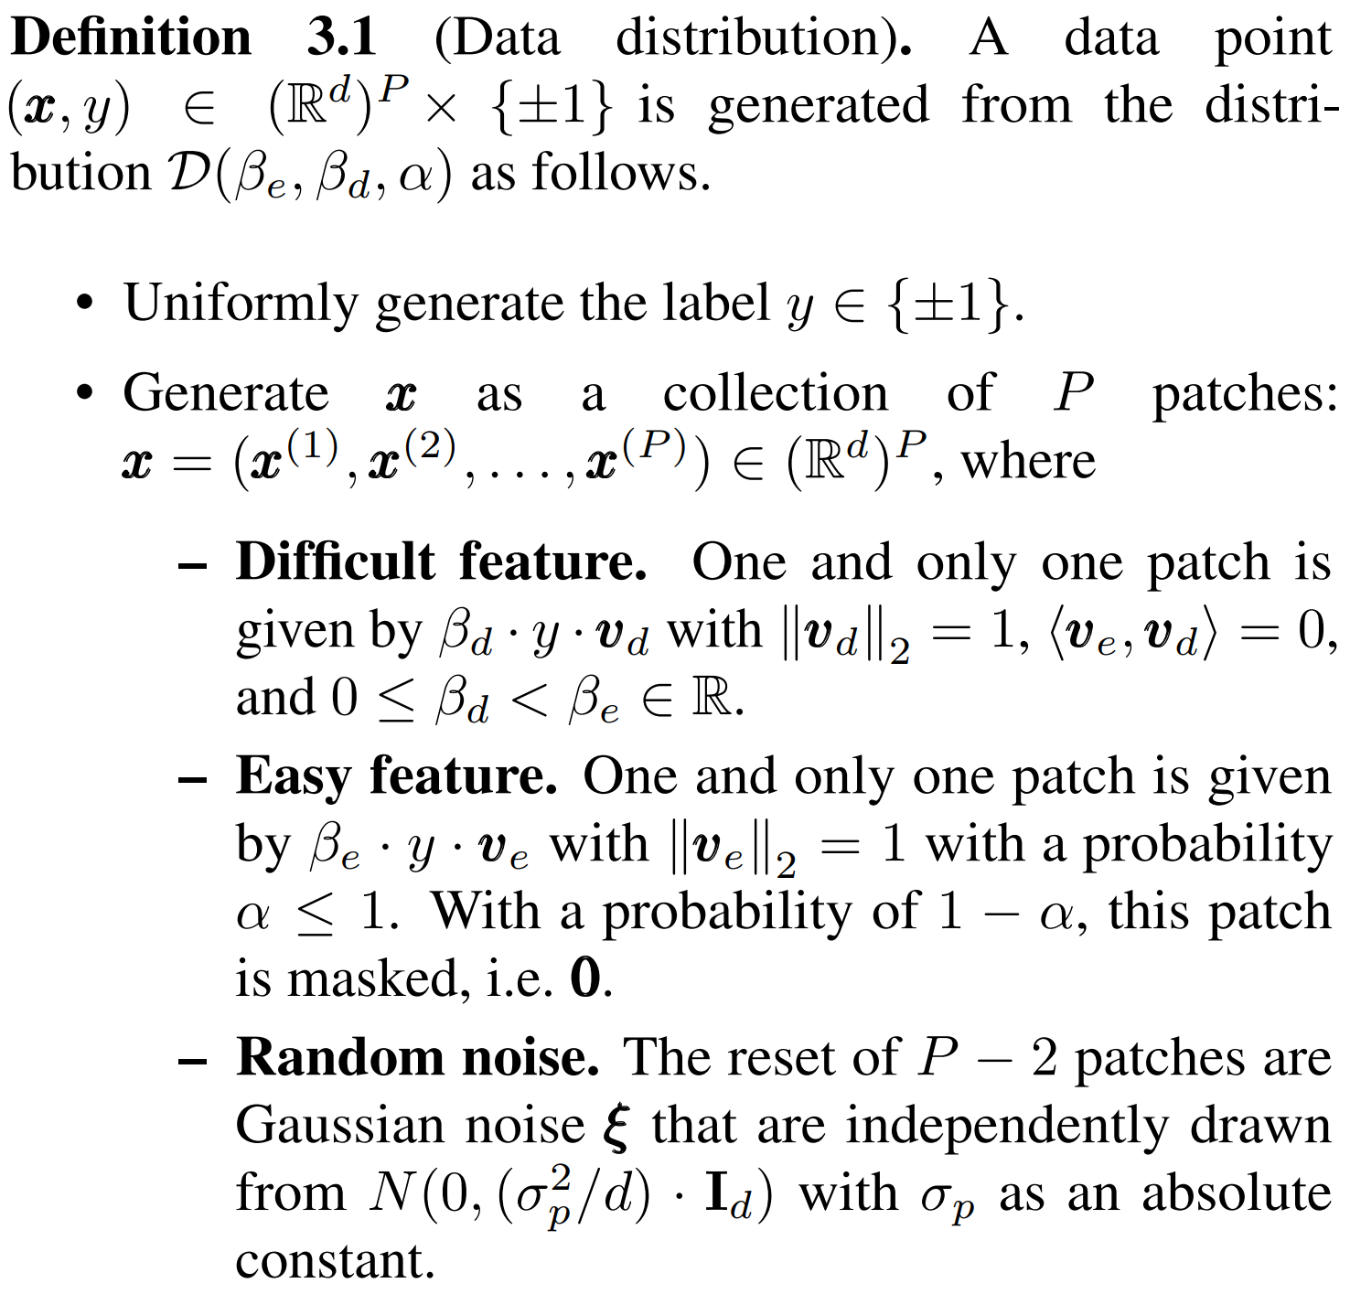
The importance of SAM is the strength of difficult feature.

Slide 15
The importance of SAM is the strength of difficult feature.

Slide 16
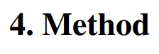
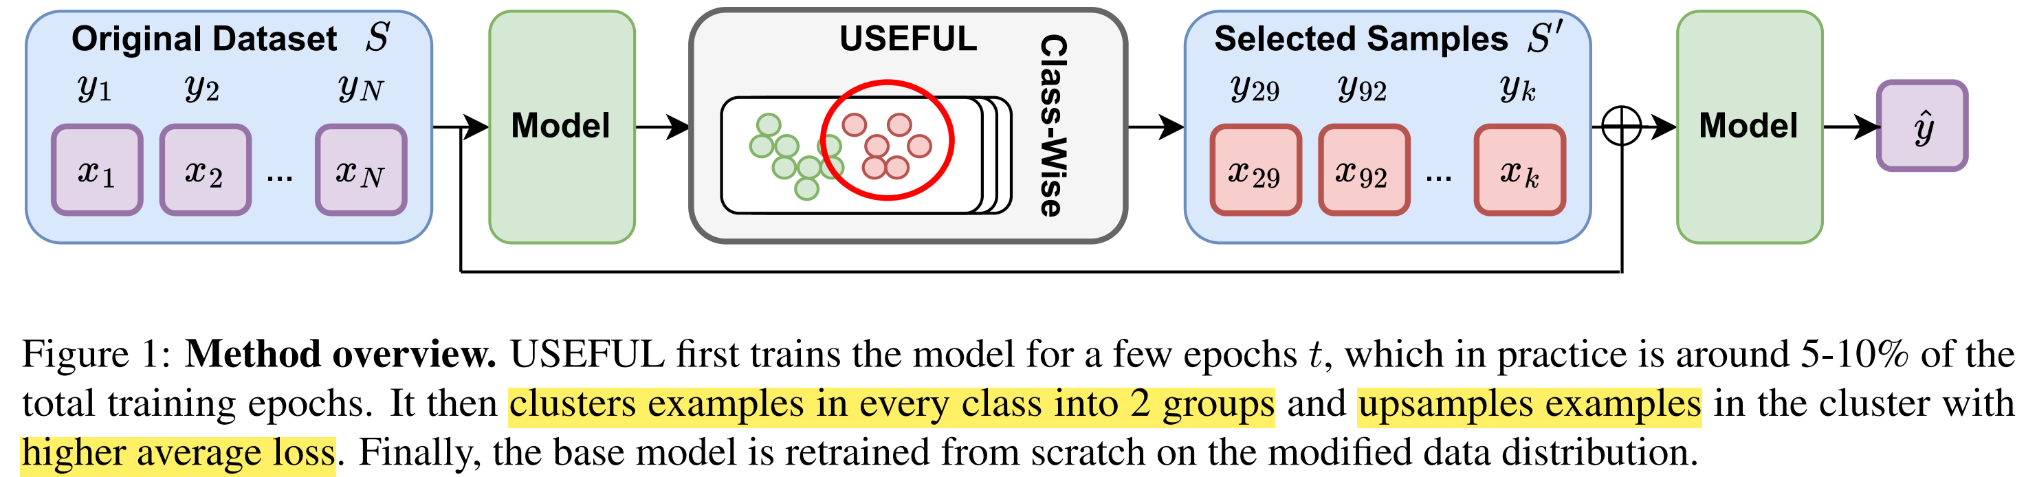
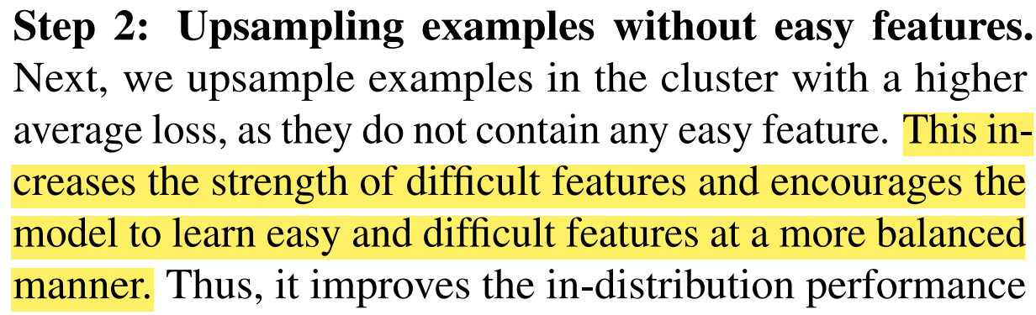
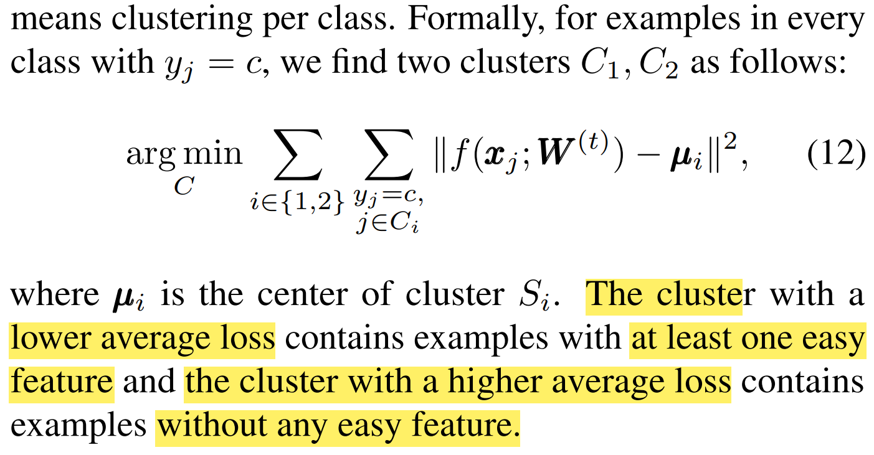
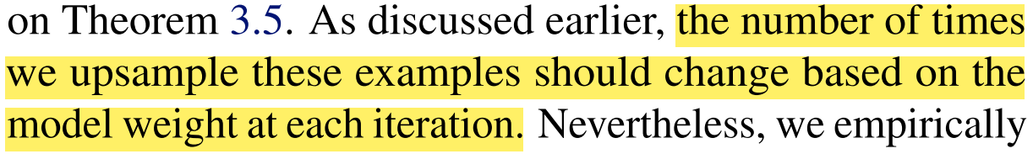
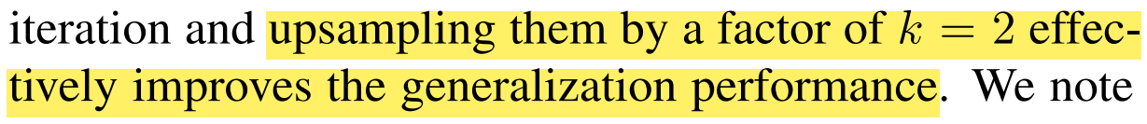
UpSample Early For Uniform Learning (USEFUL)

Slide 17
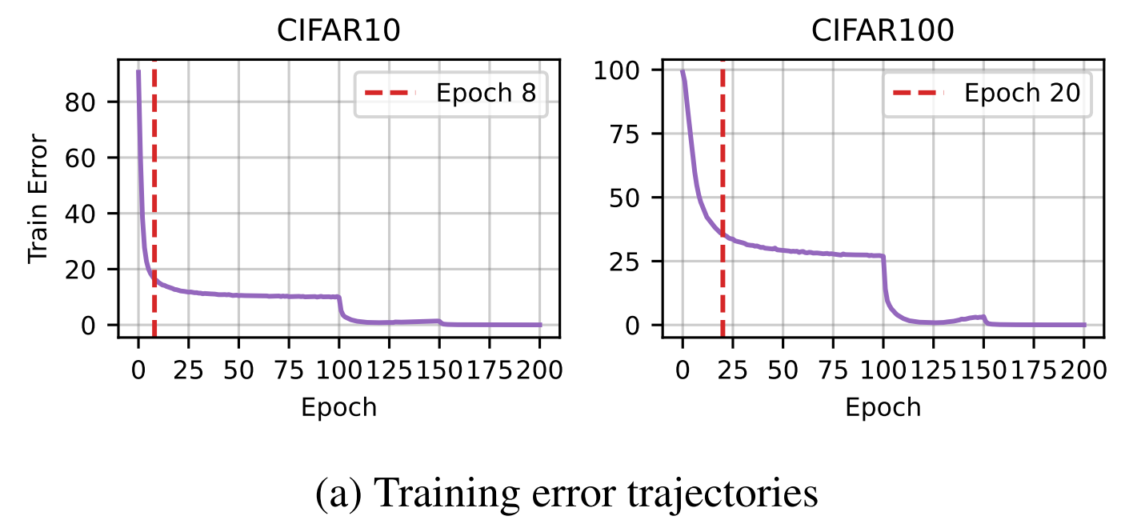

Slide 18
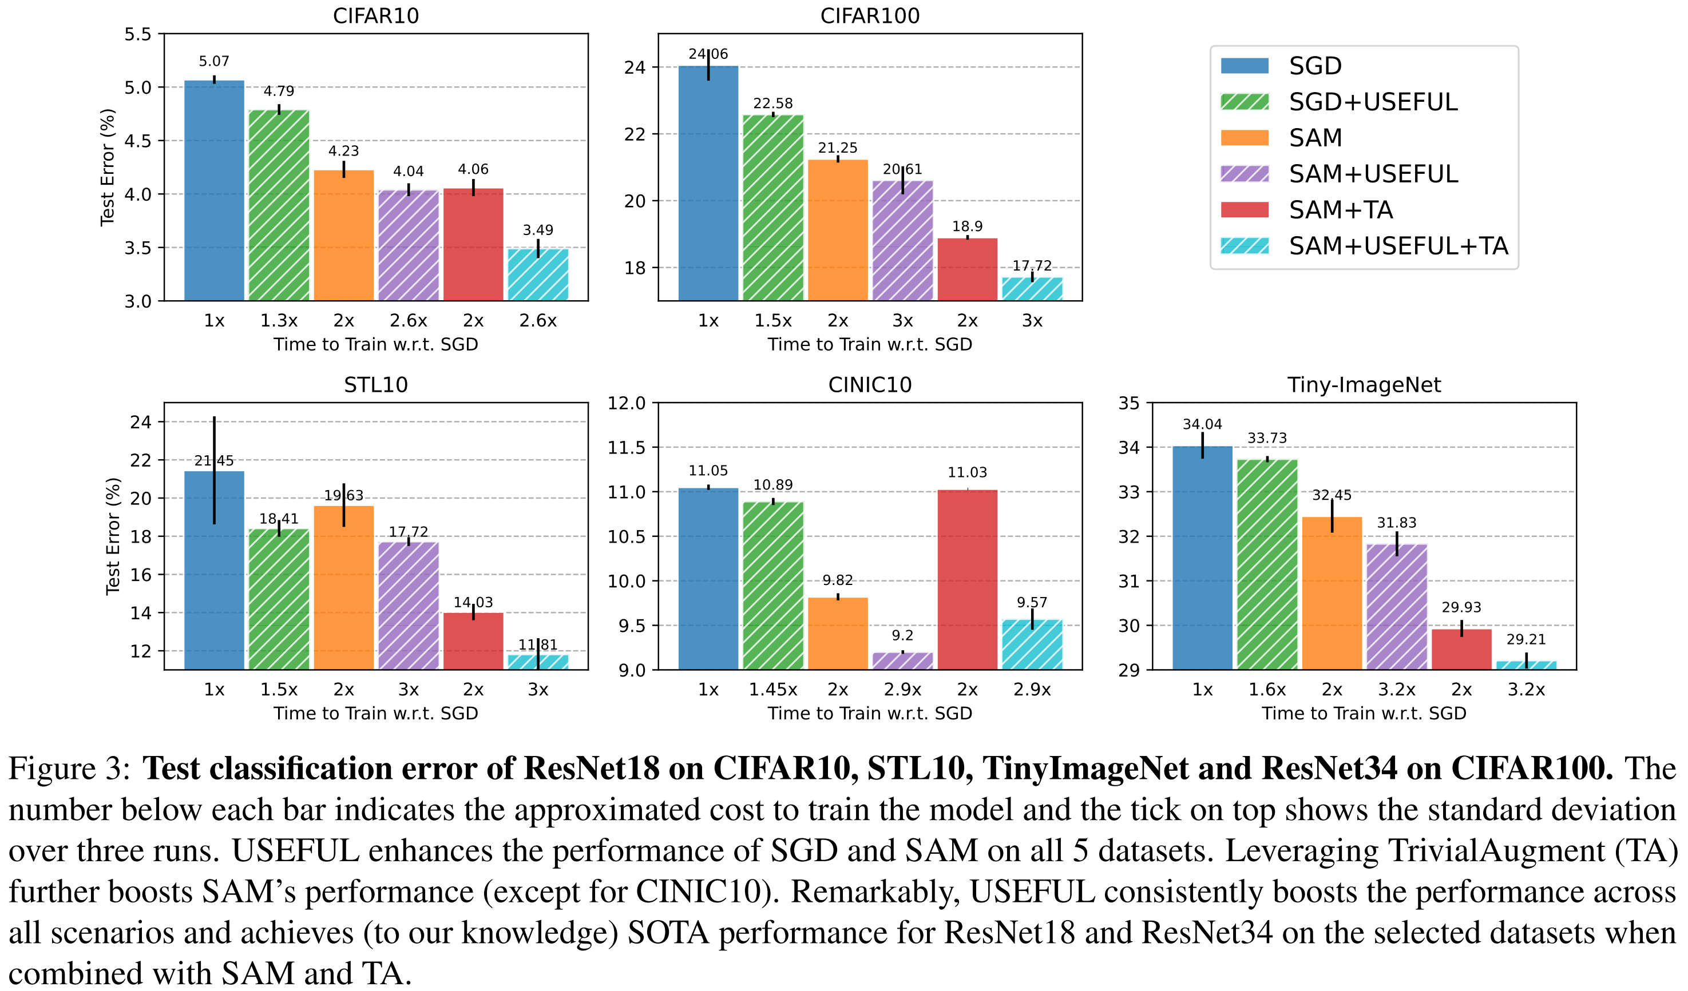

Slide 19
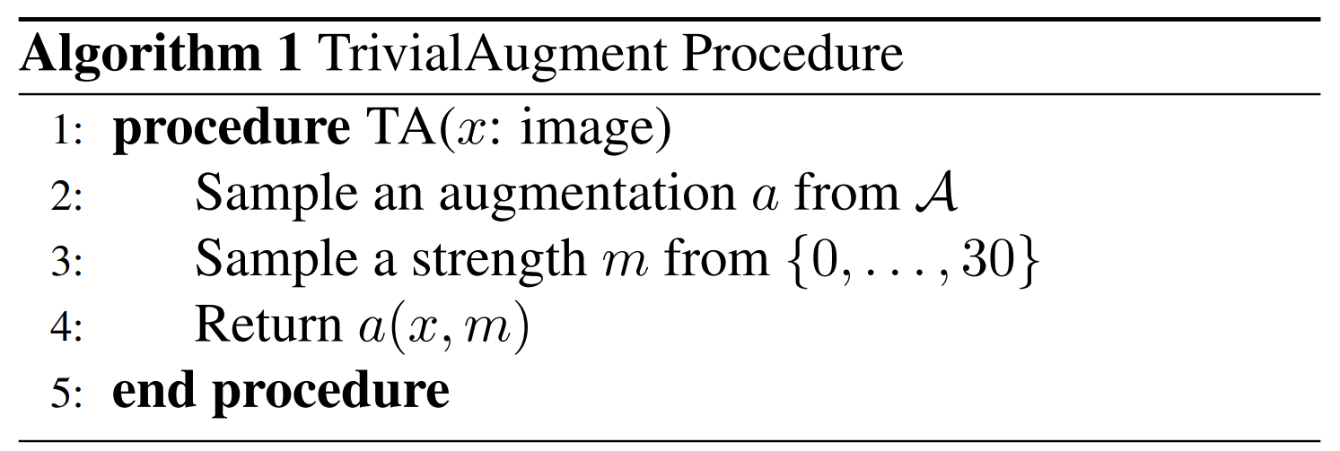
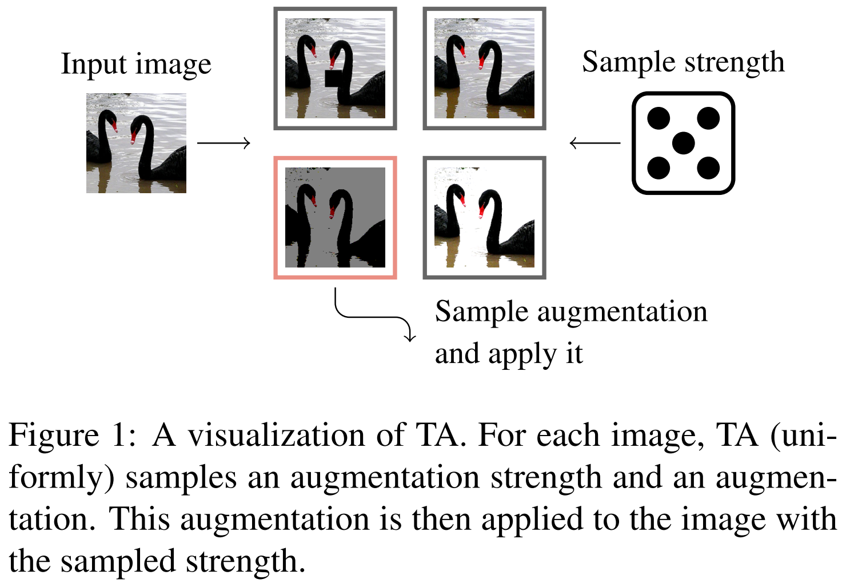
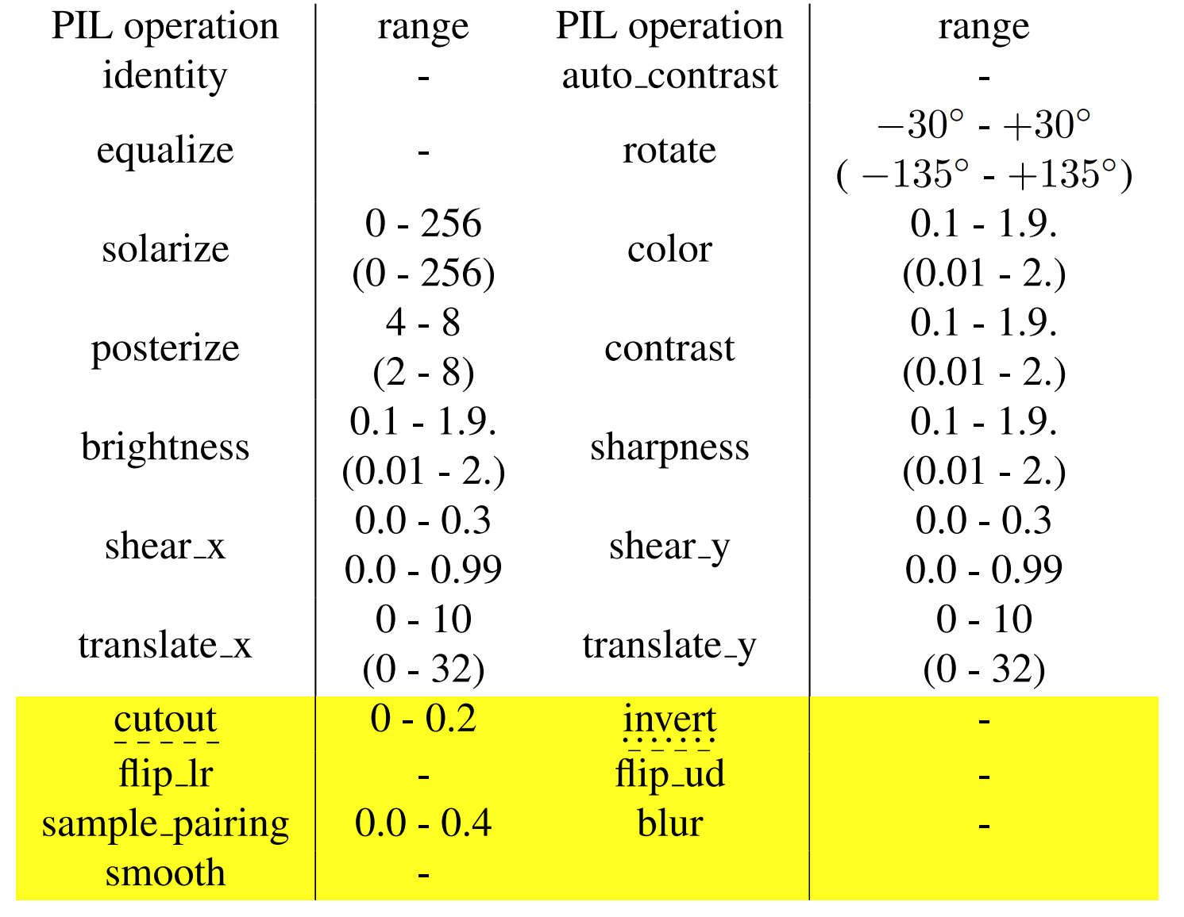
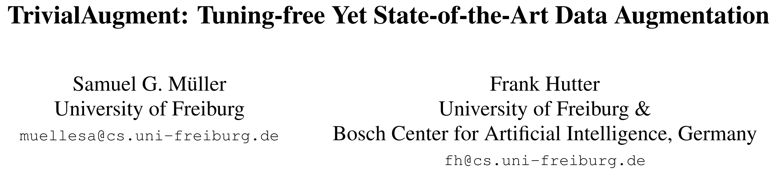
CVPR 2021

Slide 20
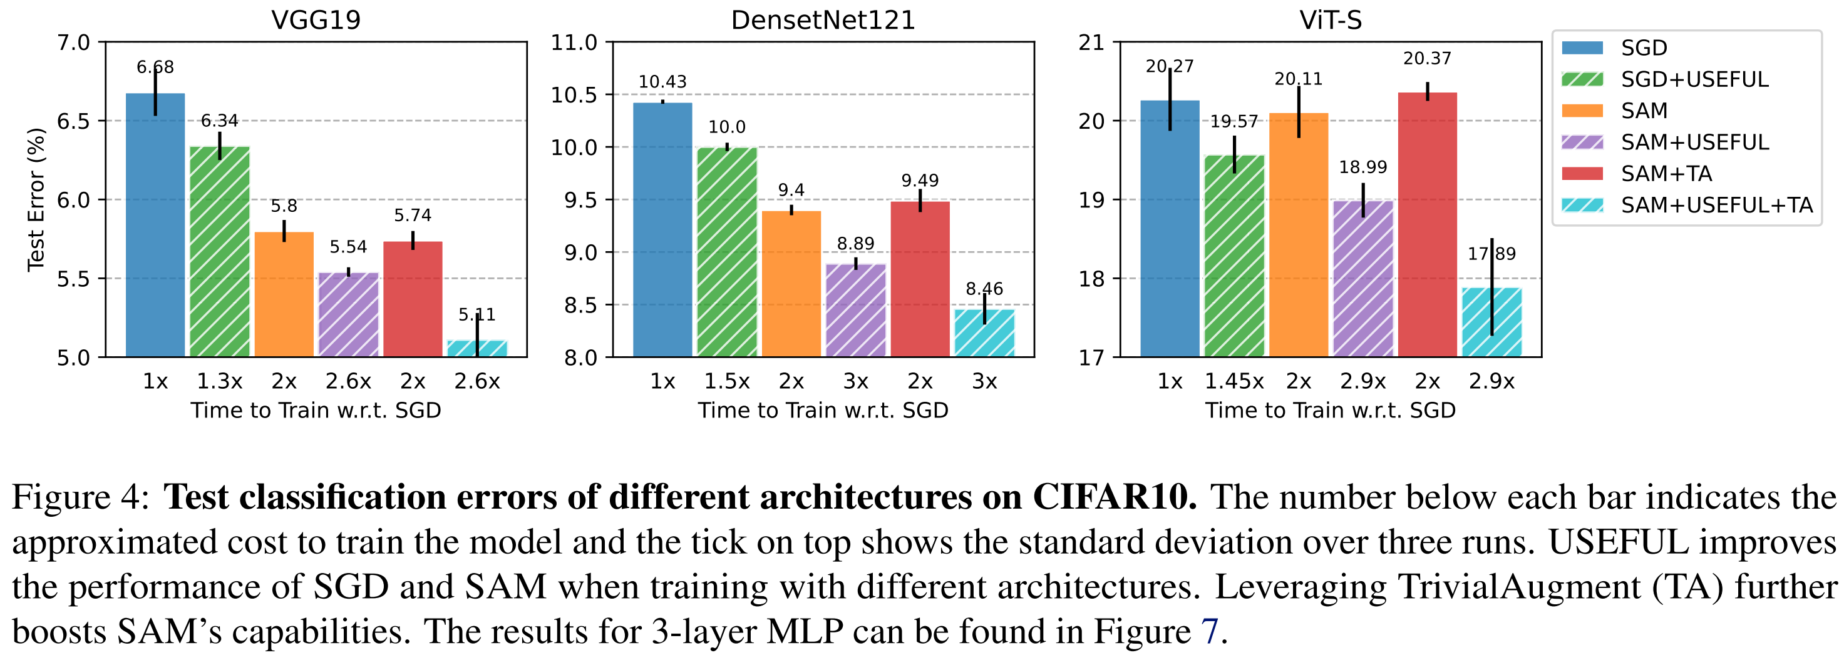

Slide 21
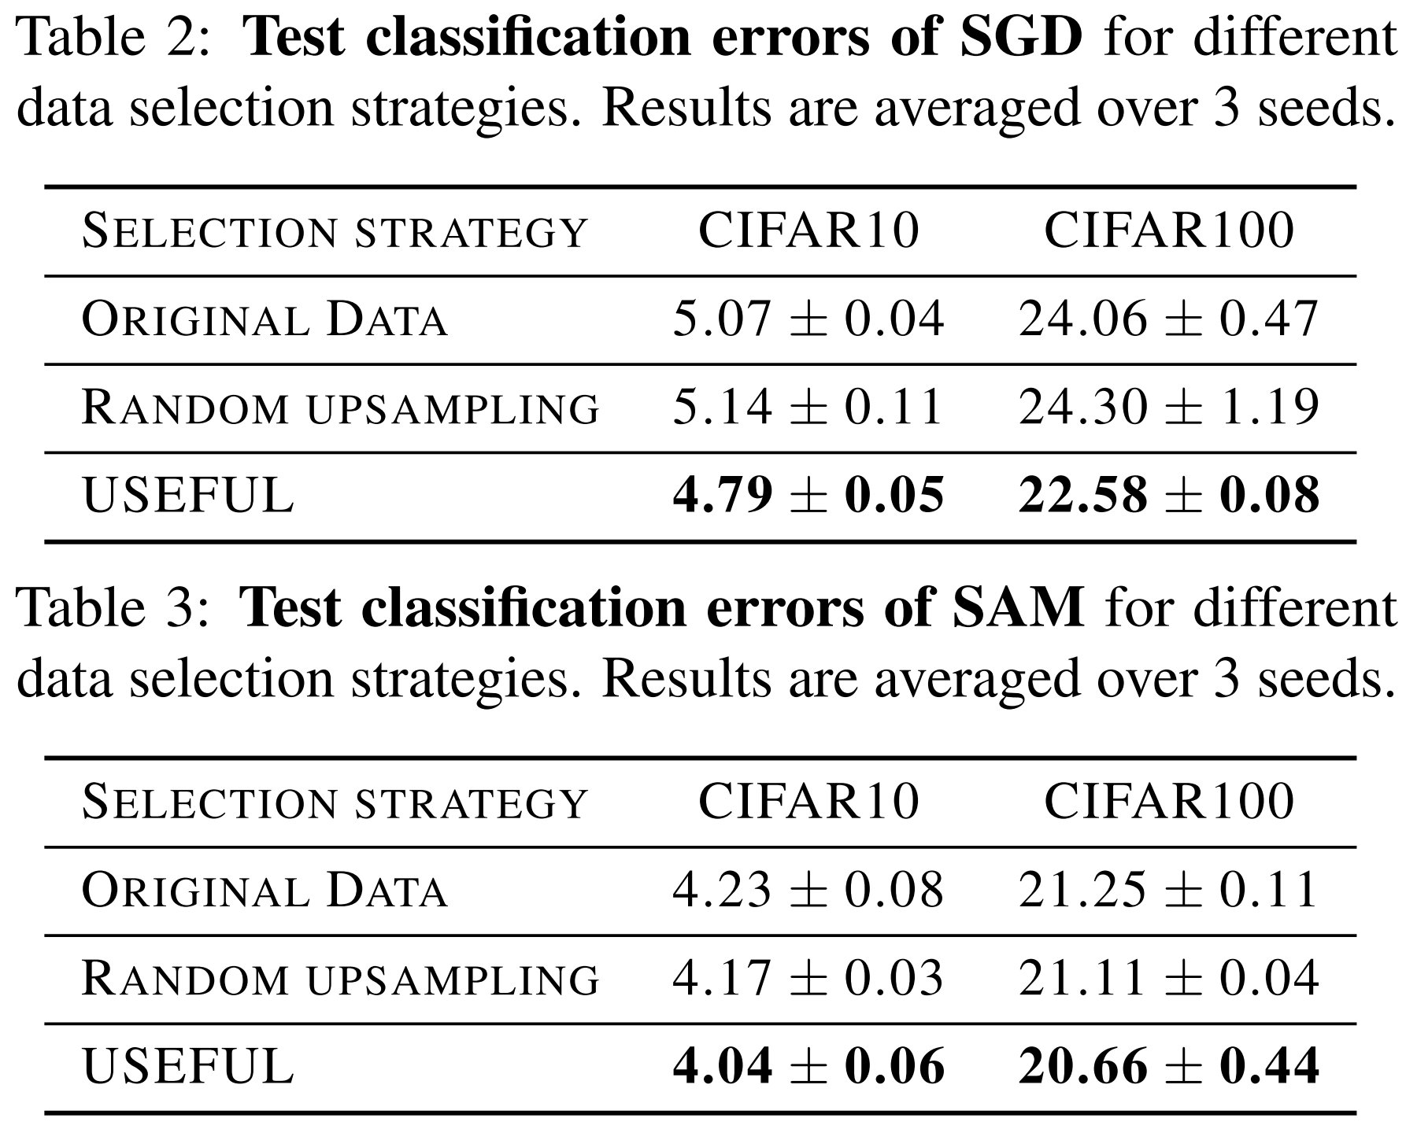
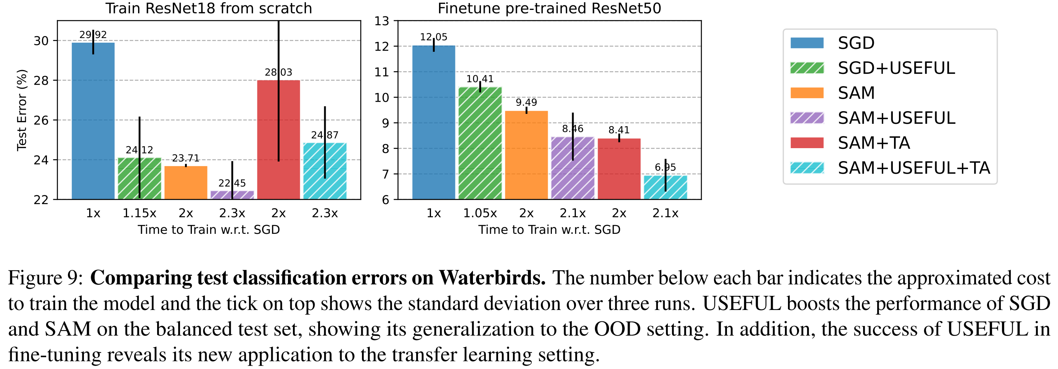

Slide 22
Appendix
[1] Sharpness-aware Minimization for Efficiently Improving Generalization. ICLR 2021.
[2] Adahessian: An adaptive second order optimizer for machine learning. AAAI 2021.
[3] TrivialAugment: Tuning-free Yet State-of-the-Art Data Augmentation. CVPR 2021.
[4] A Sharpness-aware minimization enhances feature quality via balanced learning. ArXiv 2024.

Slide 23
THANKS

